Slide 1
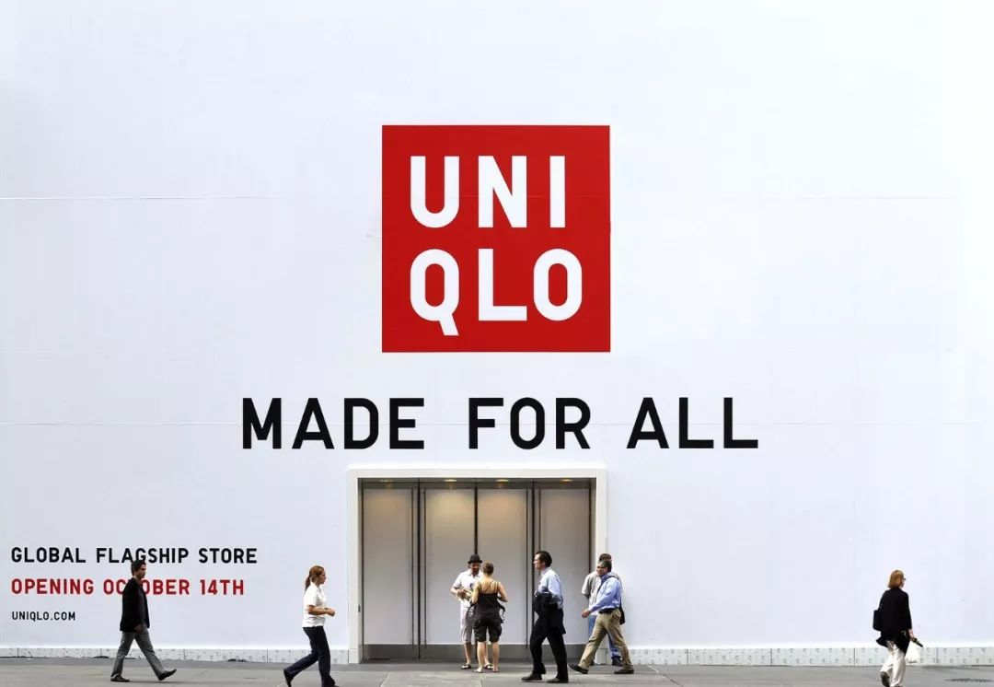
UNIQLO
IMC Effectiveness Analysis of Print VS Digital Media for UNIQLO UT Collection
REPORTER : Judy Cecilia
TIME : 2025/11/20

Slide 2
01
PART ONE
Introduction
UNIQLO

Slide 3
Introduction
UNIQLO UT uses print and digital media for "IP collaboration + omnichannel" IMC.
The print case is the 2025 Demon Slayer UT subway ad, and the digital case is the 2019 UT Tiktok challenge that drove sales growth.
Print media follows "IP coding → billboard → in-store inquiry", while digital media follows "influencer coding → TikTok → user interaction/purchase".
UNIQLO UT’s core users are 18-25-year-old students, with consumption motivations of nostalgia, social connection and practicality.

Slide 4
02
PART TWO
Print Advertising
Analysis of LifeWear Magazine Brochure
UNIQLO

Slide 5
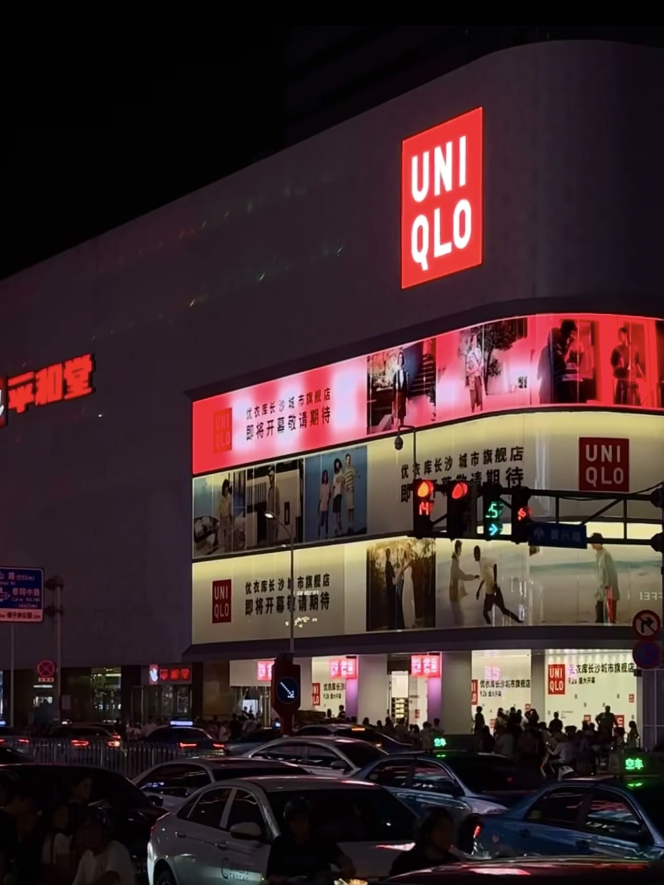
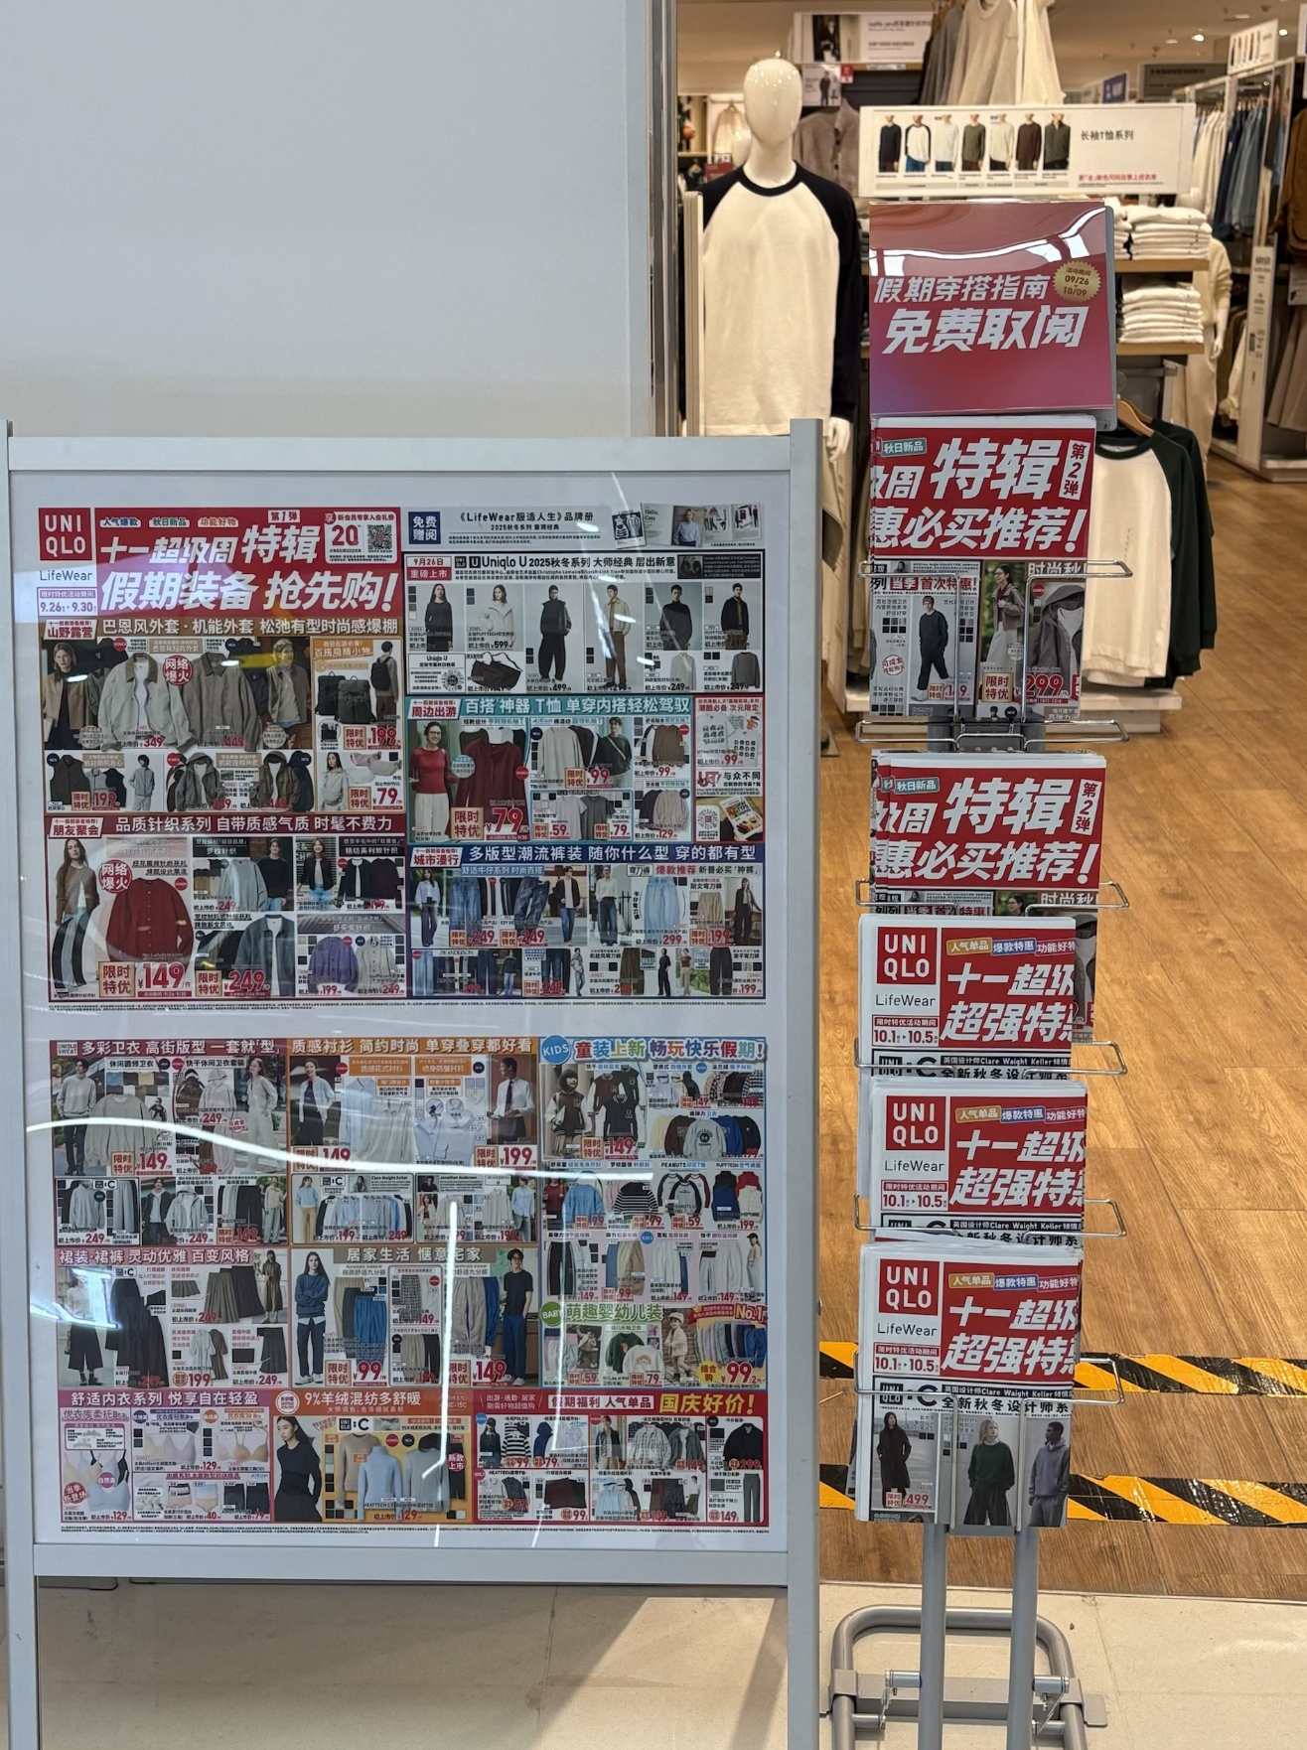
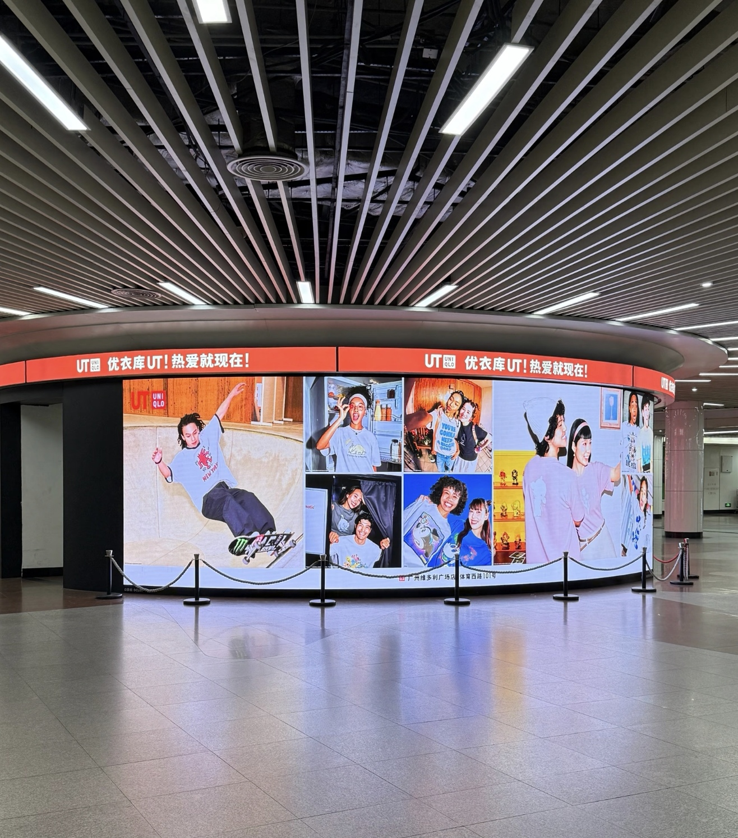
Print Advertising

Slide 6
Print Advertising
Advantages
Disadvantages
High exposure, strengthen brand awareness.
Can't interact in real time feedback is delayed.
Physical presence enhances brand credibility.
High investment cost and low audience accuracy.
Perfect for conveying IP sentiment and value.
Content cannot be personalized.

Slide 7
AIDA Analysis of LifeWear Magazine Brochure
Specific Performance
Corresponding UT Marketing Action
The text and retro illustration on the cover make them perceive UNIQLO is a brand with texture and cultural appeal, and link it to the "cultural carrier" positioning of the UT series.
Use magazine-style binding and illustrations to turn the brochure into a "collectible cultural reader", weaken the sense of advertising and strengthen the brand tone.
Awareness
In inner pages, users see UT collaborations, plus in-depth interpretations of fabric technology + matching scenarios, and become curious about the cultural stories behind UT.
Set up "designer interviews + cultural theme interpretations" in the inner pages, turning UT from "a T-shirt" into an extension of cultural content.
Interest
When users see the benefit of participating in offline cultural salons by purchasing UT, they imagine an immersive experience of wearing UT to participate in cultural activities.
Attach a QR code for offline event registrationat the end of the brochure, and amplify the desire to purchase with "cultural experience".
Desire
Use the discount code in the brochure to purchase the corresponding UT in stores/online, or scan the "matching list for the same style" to order for the set of outfits .
Mark the location of the theme zone in stores + direct link for online purchase" in the inner pages to reduce the cost of purchase decision-making.
Action

Slide 8
03
PART THREE
Digital Advertising
E.g. 2025 Minecraft TikTok Challenge
UNIQLO

Slide 9
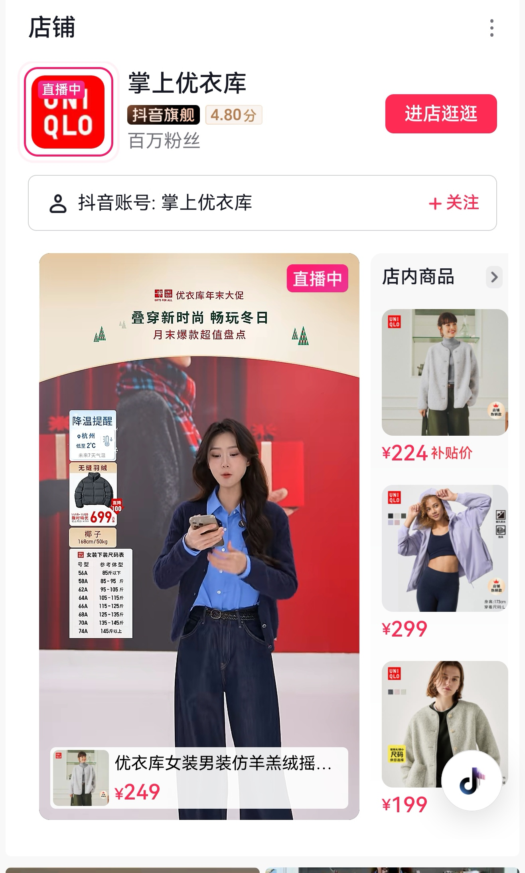
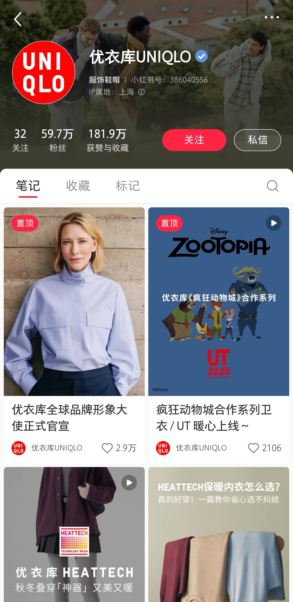
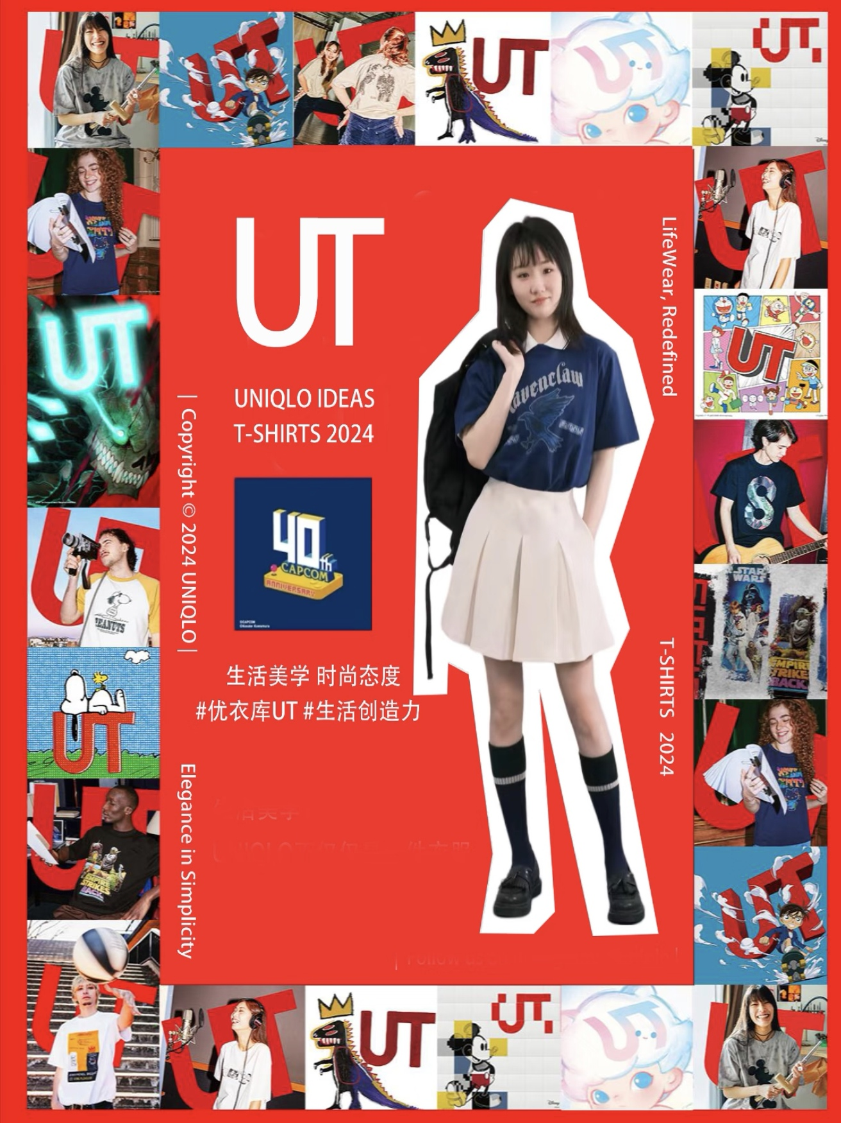
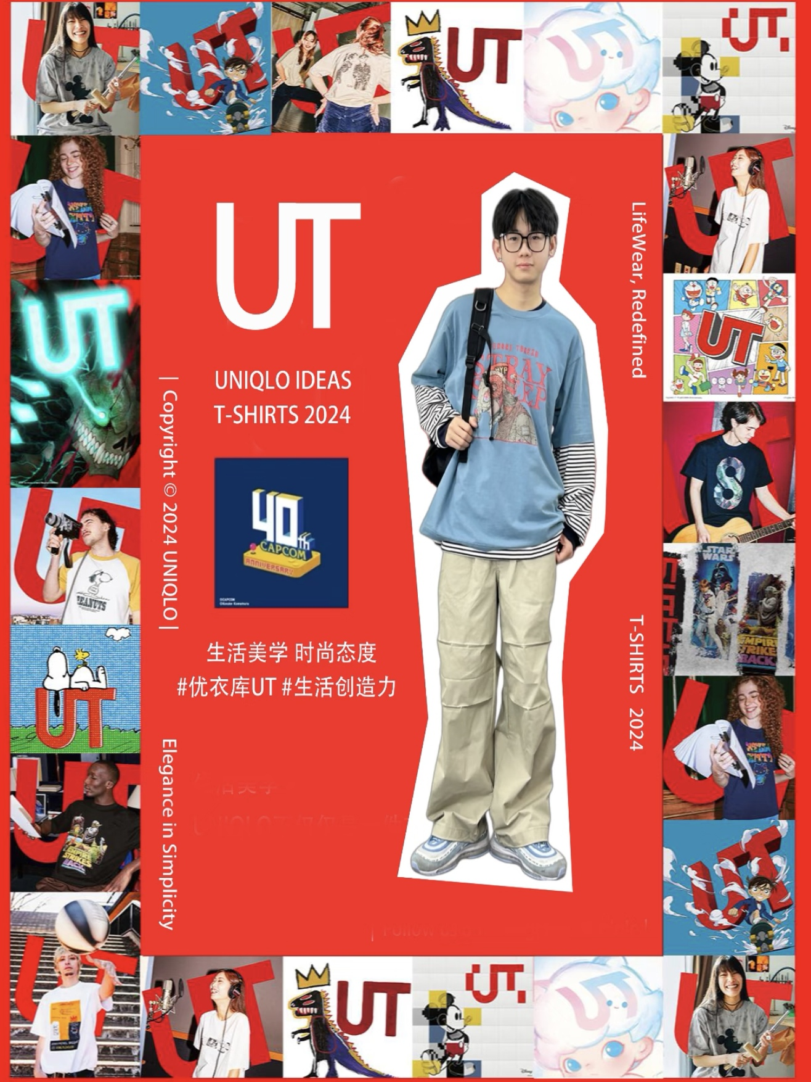
Digital Advertising

Slide 10
Digital Advertising
Advantages
Disadvantages
High interactivity, supports UGC secondary sharing.
Information overload, audience attention scattered.
Exposure is unstable due to the platform algorithm.
Real-time data tracking.
Perfect for conveying IP sentiment and value.
Content cannot be personalized.

Slide 11
AIDA Analysis of Digital advertising
(E.g. 2025 Minecraft TikTok Challenge)
Specific Performance
Corresponding UT Marketing Action
Tiktok users brushed the video of "building blocks in UT" released by the expert "Mini World Fans", and saw the topic # UT box challenge.
Awareness
The first 5 seconds of the video display "Minecraft" UT print.
The challenge rules state: "Post the same outfit video to win Minecraft merchandise." This encourages users to participate.
The video has a shopping link with "Click to buy UT to join the challenge".
Interest
Seeing the comment “Worn UT to check in at the game expo,” users are eager for validation from their social circle.
Pin this topic to the feed.
Premium posts will be featured in a carousel on UNIQLO stores.
Desire
Click on the link to purchase UT, shoot and post a dressing video.
TikTok automatically associates topics, lowering the barrier to posting.
Action

Slide 12
04
PART FOUR
7P THEORY
Marketing Mix
(Application of The 7P Theory)
UNIQLO

Slide 13
Marketing Mix (Application of The 7P Theory)
PRODUCT：IP-collaborated T-shirts that blend cultural appeal with essential functionality.
PRICE：79-150 yuan, suitable for young people's spending power.
PLACE：Offline stores + online e-commerce + social media direct purchase.
PROMOTION：Print advertisements (exposure) + Digital Challenge (interactive).
PEOPLE：Store staff provide styling suggestions, influencers guide the creative process.
PROCESS：A closed-loop system integrating online purchases, logistics delivery, and UGC sharing.
PHYSICAL EVIDENCE：The IP-themed display in the store's UT section and the striking visual impact of the billboards.

Slide 14
05
PART FIVE
Conclusion
UNIQLO

Slide 15
Conclusion
Optimal Strategy Recommendations
Print Media: Used for "initial exposure" of IP co-branded models to strengthen awareness.
Digital Media: Used for "interactive conversion" and "loyalty maintenance" to extend the marketing cycle.
Combined Effect: Synergy of print + digital increased UT series sales
Ethical Dilemmas
Controversy over "excessive commercialization" of IP collaborations.
"Data privacy" risks of digital challenges.

Slide 16
06
PART SIX
References
UNIQLO

Slide 17
References
Aaker, D. A. (1991). Managing brand equity: Capitalizing on the value of a brand name. Free Press.
Lavidge, R. J., & Steiner, G. A. (1961). A model for predictive measurements of advertising effectiveness. Journal of Marketing, 25(6), 59-62.
Sohu.com. (2019, July 3). First time ever! UNIQLO launches global challenge, fun marketing frequently creates bestsellers! Retrieved from https://www.sohu.com/a/324606193_587311
Zhao, J., & Sun, M. M. (2022). Research on influencing factors of user acceptance of cross-border marketing. Journal of Yichun University, 44(1), 37-44.
Niaoge Notes. (2023, April 18). Sichuan brand marketing (brand marketing research). Retrieved from https://www.niaogebiji.com/article-557467-1.html
Advertiser Dry Goods Library. (2023, December 17). Talking about Consumer Journey. Retrieved from https://www.ganhuoku.cn/archives/256635

Slide 18
THANK YOU FOR LISTENING
UNIQLO
IMC Effectiveness Analysis of Print VS Digital Media for UNIQLO UT Collection
REPORTER : Judy Cecilia
TIME : 2025/11/20

